Slide 1
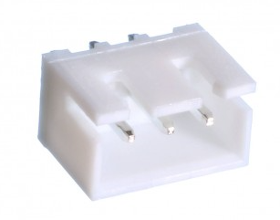
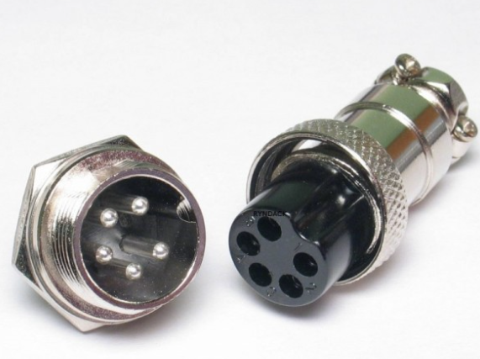
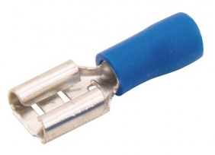
Conector Mike
5 vias Femea
Conector Macho XH
3 Vias 2,5mm 180°
marron
1
laranja
1 ( Sinal )
2
2 ( -5V )
3
2
1
amarelo
3
3 ( +5V )
5
verde
4
4
Retorno Rele
vermelho
1
5
+24V
3
2
1
1 ( Sinal )
2
2 ( -5V )
1
3
3 ( +5V )
2
4
Retorno Rele
3
5
4
5
+24V
Conector Mike
5 vias Macho

